Slide 1
End-to-End Simultaneous Learning of Single-particle Orientation and 3D Map Reconstruction from Cryo-electron Microscopy Data
林思涵
2021/10/26

Slide 2
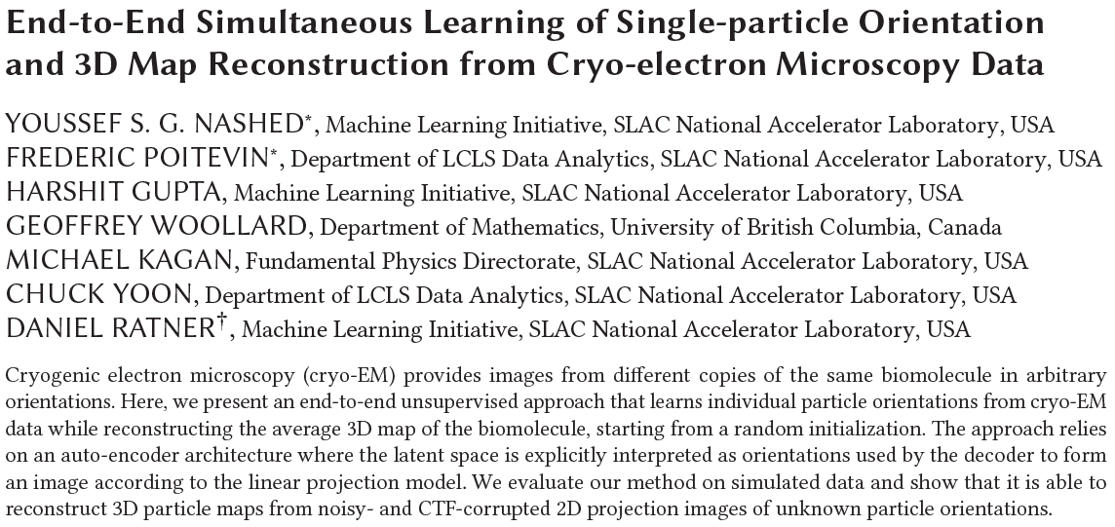

Slide 3
Outline
Background and Current methods
Proposed Method
Results

Slide 4
Background and Current methods

Slide 5
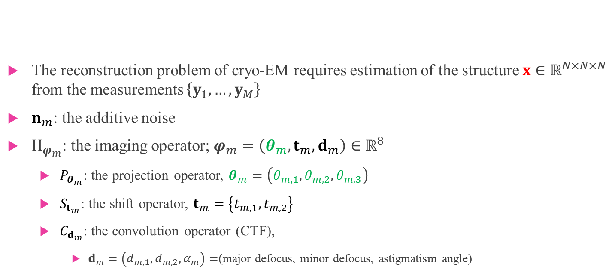


$$y_{m}=C_{d_{m}}∗S_{t_{m}}\left\{P_{θ_{m}}\left\{x\right\}\right\}+n_{m}$$
$$H_{φ_{m}}$$
The reconstruction problem of cryo-EM requires estimation of the structure $x∈ℝ^{N×N×N}$ from the measurements $\left\{y_{1},…,y_{M}\right\}$
$n_{m}$: the additive noise
$H_{φ_{m}}$: the imaging operator; $φ_{m}=\left(θ_{m},t_{m},d_{m}\right)∈ℝ^{8}$
$P_{θ_{m}}$: the projection operator, $θ_{m}=\left(θ_{m,1},θ_{m,2},θ_{m,3}\right)$
$S_{t_{m}}$: the shift operator, $t_{m}=\left\{t_{m,1},t_{m,2}\right\}$
$C_{d_{m}}$: the convolution operator (CTF),
$d_{m}=\left(d_{m,1},d_{m,2},α_{m}\right)=$(major defocus, minor defocus, astigmatism angle)

Slide 6
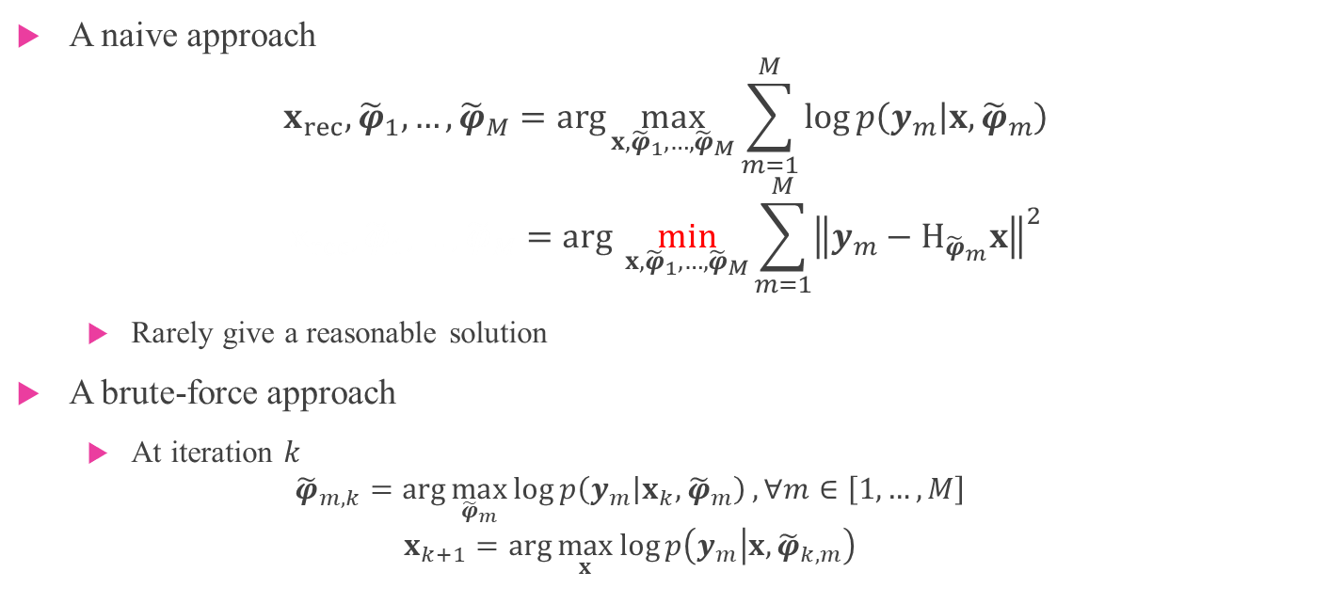
Maximum Likelihood
A naive approach
$$x_{rec},{\tilde{φ}}_{1},…,{\tilde{φ}}_{M}=\arg{\max_{x,{\tilde{φ}}_{1},…,{\tilde{φ}}_{M}}{\sum_{m=1}^{M}{\log{p\left(y_{m} | x,{\tilde{φ}}_{m}\right)}}}}$$
$$x_{rec},{\tilde{φ}}_{1},…,{\tilde{φ}}_{M}=arg \min_{x,{\tilde{φ}}_{1},…,{\tilde{φ}}_{M}}{\sum_{m=1}^{M}{{\left\|y_{m}−H_{{\tilde{φ}}_{m}}x\right\|}^{2}}}$$
Rarely give a reasonable solution
A brute-force approach
At iteration $k$
$${\tilde{φ}}_{m,k}=\arg{\max_{{\tilde{φ}}_{m}}{\log{p\left(y_{m} | x_{k},{\tilde{φ}}_{m}\right)}}}, ∀m∈\left[1,…,M\right]$$
$$x_{k+1}=\arg{\max_{x}{\log{p\left(y_{m} | x,{\tilde{φ}}_{k,m}\right)}}}$$

Slide 7
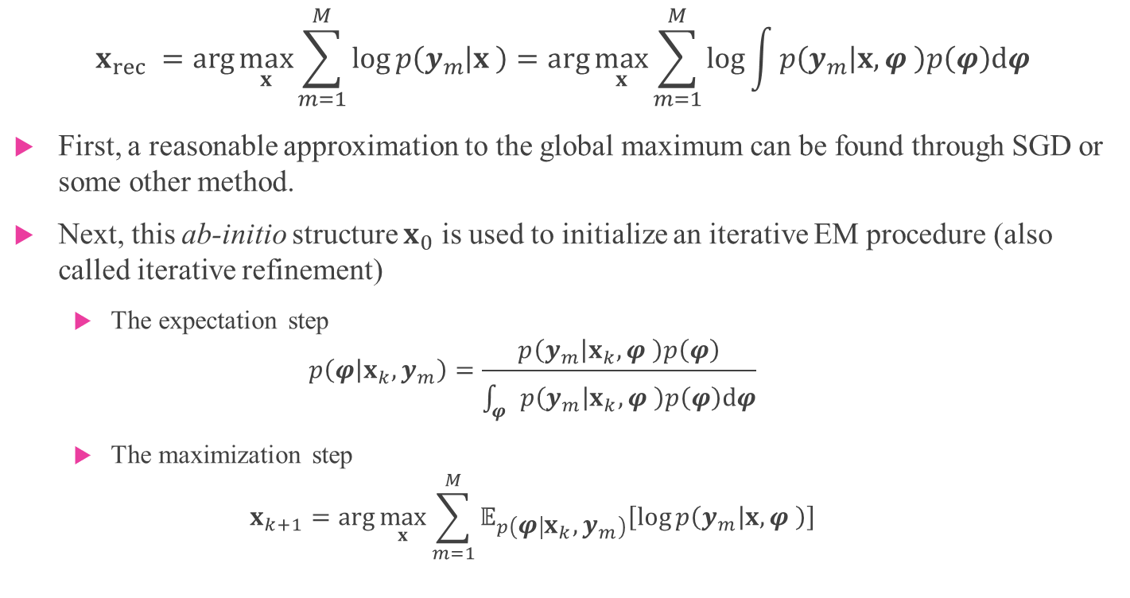
Maximum Marginalized Likelihood
$$x_{rec} =\arg{\max_{x}{\sum_{m=1}^{M}{\log{p\left(y_{m} | x \right)}}}}=\arg{\max_{x}{\sum_{m=1}^{M}{\log{\int{p\left(y_{m} | x,φ \right)p\left(φ\right)dφ}}}}}$$
First, a reasonable approximation to the global maximum can be found through SGD or some other method.
Next, this ab-initio structure $x_{0}$ is used to initialize an iterative EM procedure (also called iterative refinement)
The expectation step
$$p\left(φ | x_{k},y_{m}\right)=\frac{p\left(y_{m} | x_{k},φ \right)p\left(φ\right)}{\int_{φ}{p\left(y_{m} | x_{k},φ \right)p\left(φ\right)dφ}}$$
The maximization step
$$x_{k+1}=\arg{\max_{x}{\sum_{m=1}^{M}{𝔼_{p\left(φ | x_{k},y_{m}\right)}\left[\log{p\left(y_{m} | x,φ \right)}\right]}}}$$

Slide 8
Proposed Method

Slide 9
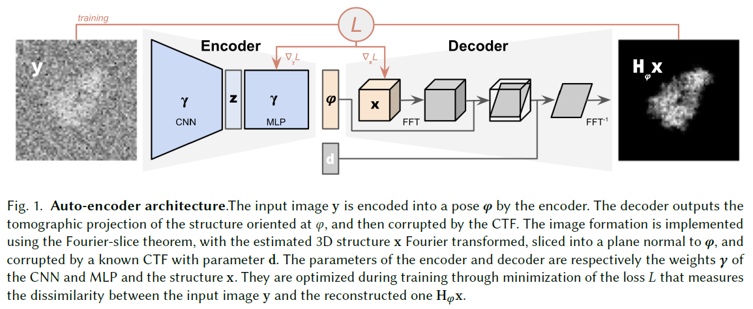
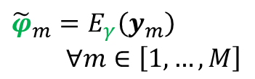


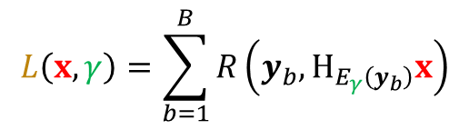
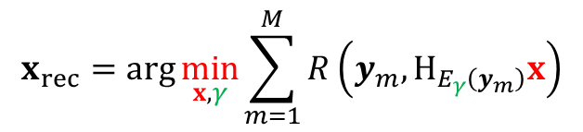
Auto-encoder architecture
$$L\left(x,γ\right)=\sum_{b=1}^{B}{R\left(y_{b},H_{E_{γ}\left(y_{b}\right)}x\right)}$$
$$H_{φ_{m}}x=C_{d_{m}}∗S_{t_{m}}\left\{P_{θ_{m}}\left\{x\right\}\right\}$$
$$x_{rec}=\arg{\min_{x,γ}{\sum_{m=1}^{M}{R\left(y_{m},H_{E_{γ}\left(y_{m}\right)}x\right)}}}$$
$${\tilde{φ}}_{m}=E_{γ}\left(y_{m}\right)$$
$∀m∈\left[1,…,M\right]$
$$R\left(y_{m},H_{E_{γ}\left(y_{m}\right)}x\right)={\left\|y_{m}−H_{E_{γ}\left(y_{m}\right)}x\right\|}^{2}$$

Slide 10
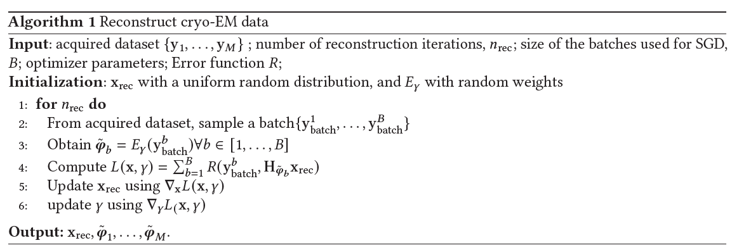

Slide 11
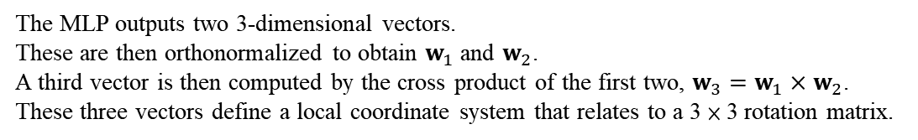
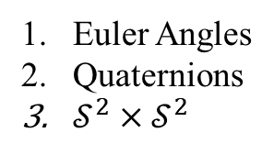
Auto-encoder architecture
$$L\left(x,γ\right)=\sum_{b=1}^{B}{R\left(y_{b},H_{E_{γ}\left(y_{b}\right)}x\right)}$$
$$x_{rec}=\arg{\min_{x,γ}{\sum_{m=1}^{M}{R\left(y_{m},H_{E_{γ}\left(y_{m}\right)}x\right)}}}$$
$${\tilde{φ}}_{m}=E_{γ}\left(y_{m}\right)$$
$∀m∈\left[1,…,M\right]$
$$R\left(y_{m},H_{E_{γ}\left(y_{m}\right)}x\right)={\left\|y_{m}−H_{E_{γ}\left(y_{m}\right)}x\right\|}^{2}$$
Euler Angles
Quaternions
$𝒮^{2}×𝒮^{2}$
The MLP outputs two 3-dimensional vectors.
These are then orthonormalized to obtain $w_{1}$ and $w_{2}$.
A third vector is then computed by the cross product of the first two, $w_{3}=w_{1}×w_{2}$.
These three vectors define a local coordinate system that relates to a 3 × 3 rotation matrix.

Slide 12
Results

Slide 13
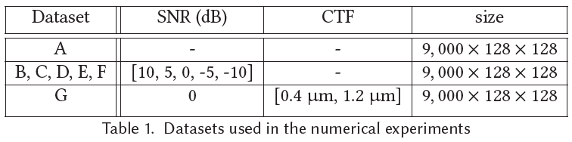
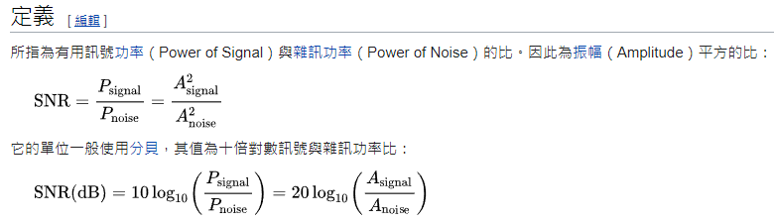
The atomic model: Adenylate kinase
The atomic model:
A small 47 kDa protein. TEM simulator was used to generate a 128 × 128 × 128 electrostatic potential map with pixel size 0.8 Å.
Datasets are generated by sampling SO(3) uniformally 10,000 times, amounting to 9,000 images for training, and 1,000 for testing.

Slide 14
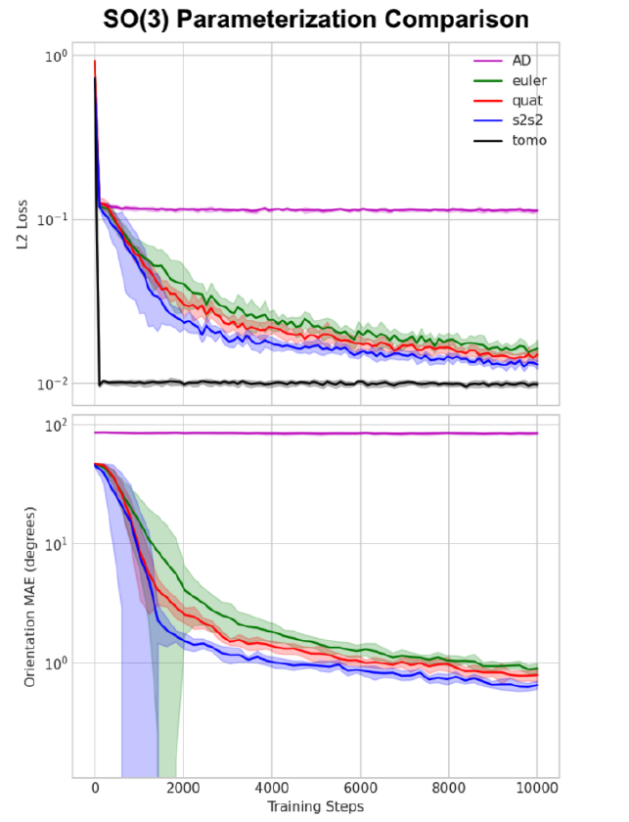

Slide 15
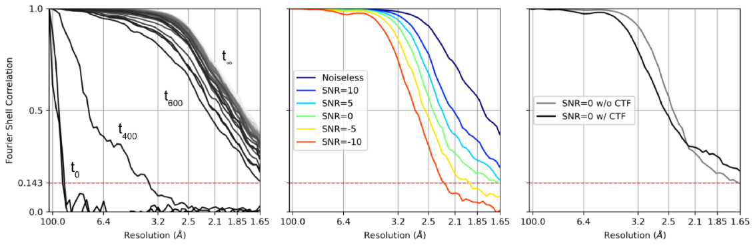
A
B,C,D,E,F
G

Slide 16
The End

